Slide 1

Design and Implementation of an E-Learning Platform
Team Members: Ahmed Mahmoud, Donia Elanany, Nada Adel Course: CCAS 4.3 Software Engineering

Slide 2
Demo – End-to-End Scenario
Use Case: Assignment Submission
Requirement:
- Students can upload assignments to specific courses.
- Instructors can view, grade, and manage submissions.
Actors: Student
Description: A student can submit their assignments for a particular course through the platform.
Preconditions:
- The student must be enrolled in the course.
- The assignment must be available for submission.
Scenario: - The student logs into the platform and navigates to the course they are enrolled in.
- They access the assignment section. - The student uploads the assignment file. - The student submits the assignment. - The system confirms the submission.
Postconditions:
- The assignment is successfully submitted, and the system updates the submission record.

Slide 3
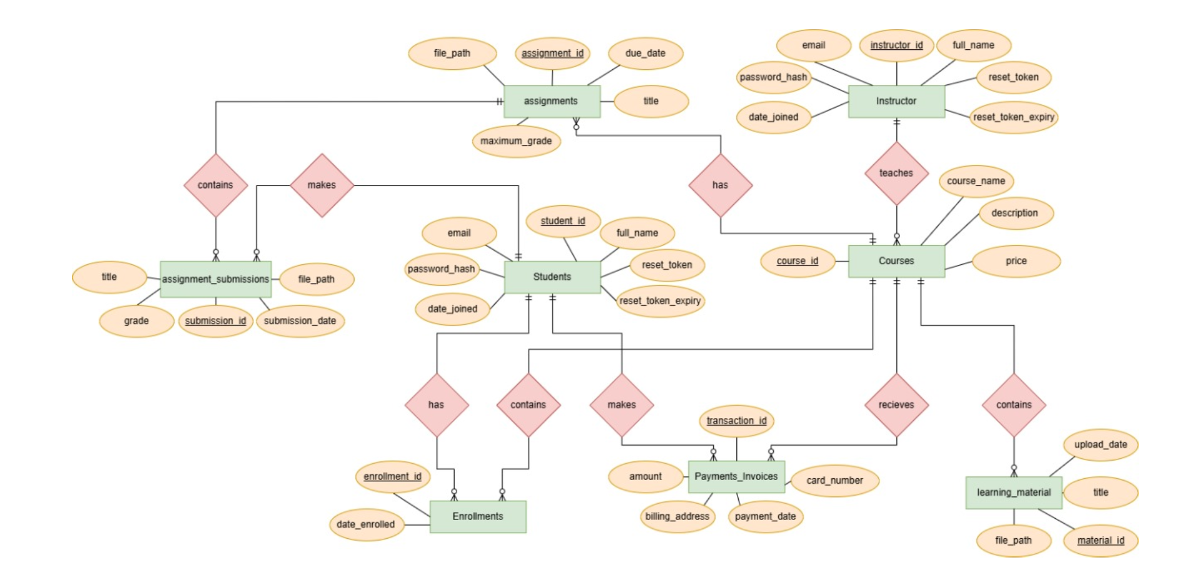
ERD and Relational Schema:

Slide 4
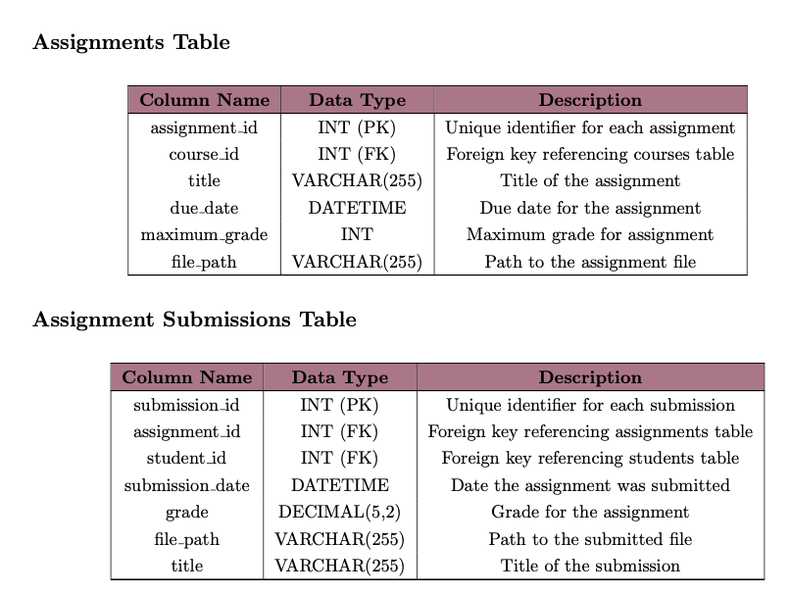

Slide 5
Queries
INSERT INTO assignment_submissions (assignment_id, student_id, file_path, title)
VALUES (--- , --- , --- , --- );
SELECT a.title, s.grade, s.submission_date
FROM assignments a
JOIN assignment_submissions s ON a.assignment_id = s.assignment_id
WHERE s.student_id = --- ;

Slide 6
Sample prompt
Prompt to design the assignment submission page:
"Create a page where students can upload assignments. The page should validate file types, show deadlines, and confirm successful submission upon upload.”

Slide 7
Prompt Engineering Techniques
Instruction-Based Prompting
The prompt explicitly provides step-by-step instructions for the task.
For this case: Specifying features like file validation, deadlines display, and success confirmation.
Context-Based Prompting
Context is embedded to clarify the task's scope and ensure relevant output.
For this case: Highlighting the specific user interaction (students uploading assignments).

Slide 8
Prompt Writing Principles
Clarity
The prompt avoids ambiguity and uses specific terms like "validate file types," "show deadlines," and "confirm submission."
Context
Provides situational context: the page is for students, and its purpose is assignment submission.
Precision
The prompt specifies exact requirements ("validate file types" and "confirm successful submission") without leaving room for misinterpretation.
Structured Requirements
The prompt organizes the task into distinct functionalities, making it easier for the model to understand and execute.
Iterative Output Expectation
The design includes steps that allow iterative improvement (e.g., checking validation and deadlines before confirming submission).

Slide 9
Test Cases:
TC 016: Submit an assignment successfully.
Steps: Log in, navigate to course, upload file, and submit.
Expected Result: System confirms successful submission.
TC 018: Submit an assignment after the due date.
Steps: Attempt submission for overdue assignment.
Expected Result: Error message “Assignment due date has passed.”

Slide 10
Test Report:
All related test cases were executed successfully.
No defects were discovered.

Slide 11
Reflection
Challenge 1: Broad Prompt Engineering
Issue: Generic outputs from initial prompts.
Solution: Iterated prompts with more details, examples, and constraints.
Challenge 2: Complex Feature Integration
Issue: Linking user authentication, courses, payments, etc. while managing schemas.
Solution: Adopted a modular approach using an ER diagram and requirements table to guide design.
Challenge 3: Changing Requirements Due to Time Constraints
Issue: Initial requirements were extensive, but time constraints forced us to reduce scope.
Solution: Refocused on core features and adjusted priorities to meet deadlines effectively.

Slide 12
What Worked Well:
Iterative prompting for refining features.
Incremental testing for uncovering issues early.
Collaborative workflow to leverage team strengths.
What To Improve:
Improved Automated Testing:
Issue: While manual testing was done, automatic testing would have increased reliability.
Action: Incorporate automated test framework from the start.
Front-End Framework (React):
Issue: Used raw HTML, CSS, and JavaScript, which led to challenges in code organization.
Action: For future projects, switch to a component-based framework like React for better code structure, reusability, and easier updates.

Slide 13
Thank you!

